Slide 1
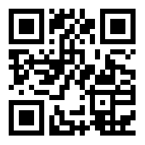
2020 AP Exam Schedule
Accommodations Deadline: January 17, 2020
Week 1 | Morning 8:00 AM | Afternoon 12:00 PM
Monday, May 4, 2020 | United States Government and Politics | Physics C: Mechanics
Tuesday, May 5, 2020 | Calculus AB Calculus BC | German Language & Culture Human Geography
Wednesday, May 6, 2020 | English Literature and Composition | European History Physics 2: Algebra-based
Thursday, May 7, 2020 | Chemistry Spanish Literature & Culture | Physics 1: Algebra-based
Friday, May 8, 2020 | United States History | Computer Science A
 | Studio Art - Last day to submit digital portfolios (by 8:00pm ET) and to gather 2-D Design and Drawing physical portfolios
Week 2 | Morning 8:00 AM | Afternoon 12:00 PM
Monday, May 11, 2020 | Biology | Environmental Science
Tuesday, May 12, 2020 | Seminar Spanish Language & Culture | Psychology
Wednesday, May 13, 2020 | English Language and Composition
Thursday, May 14, 2020 | World History: Modern | Macroeconomics
Friday, May 15, 2020 | Computer Science Principles | Statistics
SCAN TO REGISTER:

